Slide 1
Competitive Programming
20 Jan. 2023
Andrei Novikov

Slide 2
Homework Revise
UVa 10986 – Sending email – Link to the Task.
Approach:
Dijkstra algorithm.
Complexity:
Algorithm: O(N^2).
Memory: O(N).
Solution – The Code of the Solution

Slide 3
Homework Revise
UVa 01112 – Mice and Maze – Link to the Task.
Approach:
Invert connections between nodes during reading the input graph.
Run Dijkstra algorithm from the destination.
Count mice (cost nodes) that are <= time limit.
Complexity:
Algorithm: O(N^2).
Memory: O(N).
Solution – The Code of the Solution

Slide 4
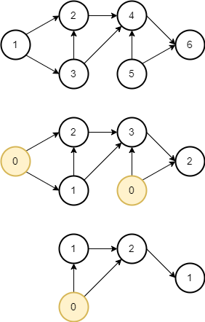
Homework Revise
UVa 10305 - Ordering Tasks – Link to the Task.
Approach:
Topological sort based on queue without priorities.
Complexity:
Algorithm: O(V+E).
Memory: O(V+E).
Solution – The Code of the Solution
Example of Topological Sort

Slide 5
Practice – Challenge #1
Resource: LeetCode
1061 Lexicographically Smallest Equivalent String – Link to the Task.
Input: s1 = "parker", s2 = "morris", baseStr = "parser"
Output: "makkek"
Input: s1 = "hello", s2 = "world", baseStr = "hold"
Output: "hdld"

Slide 6
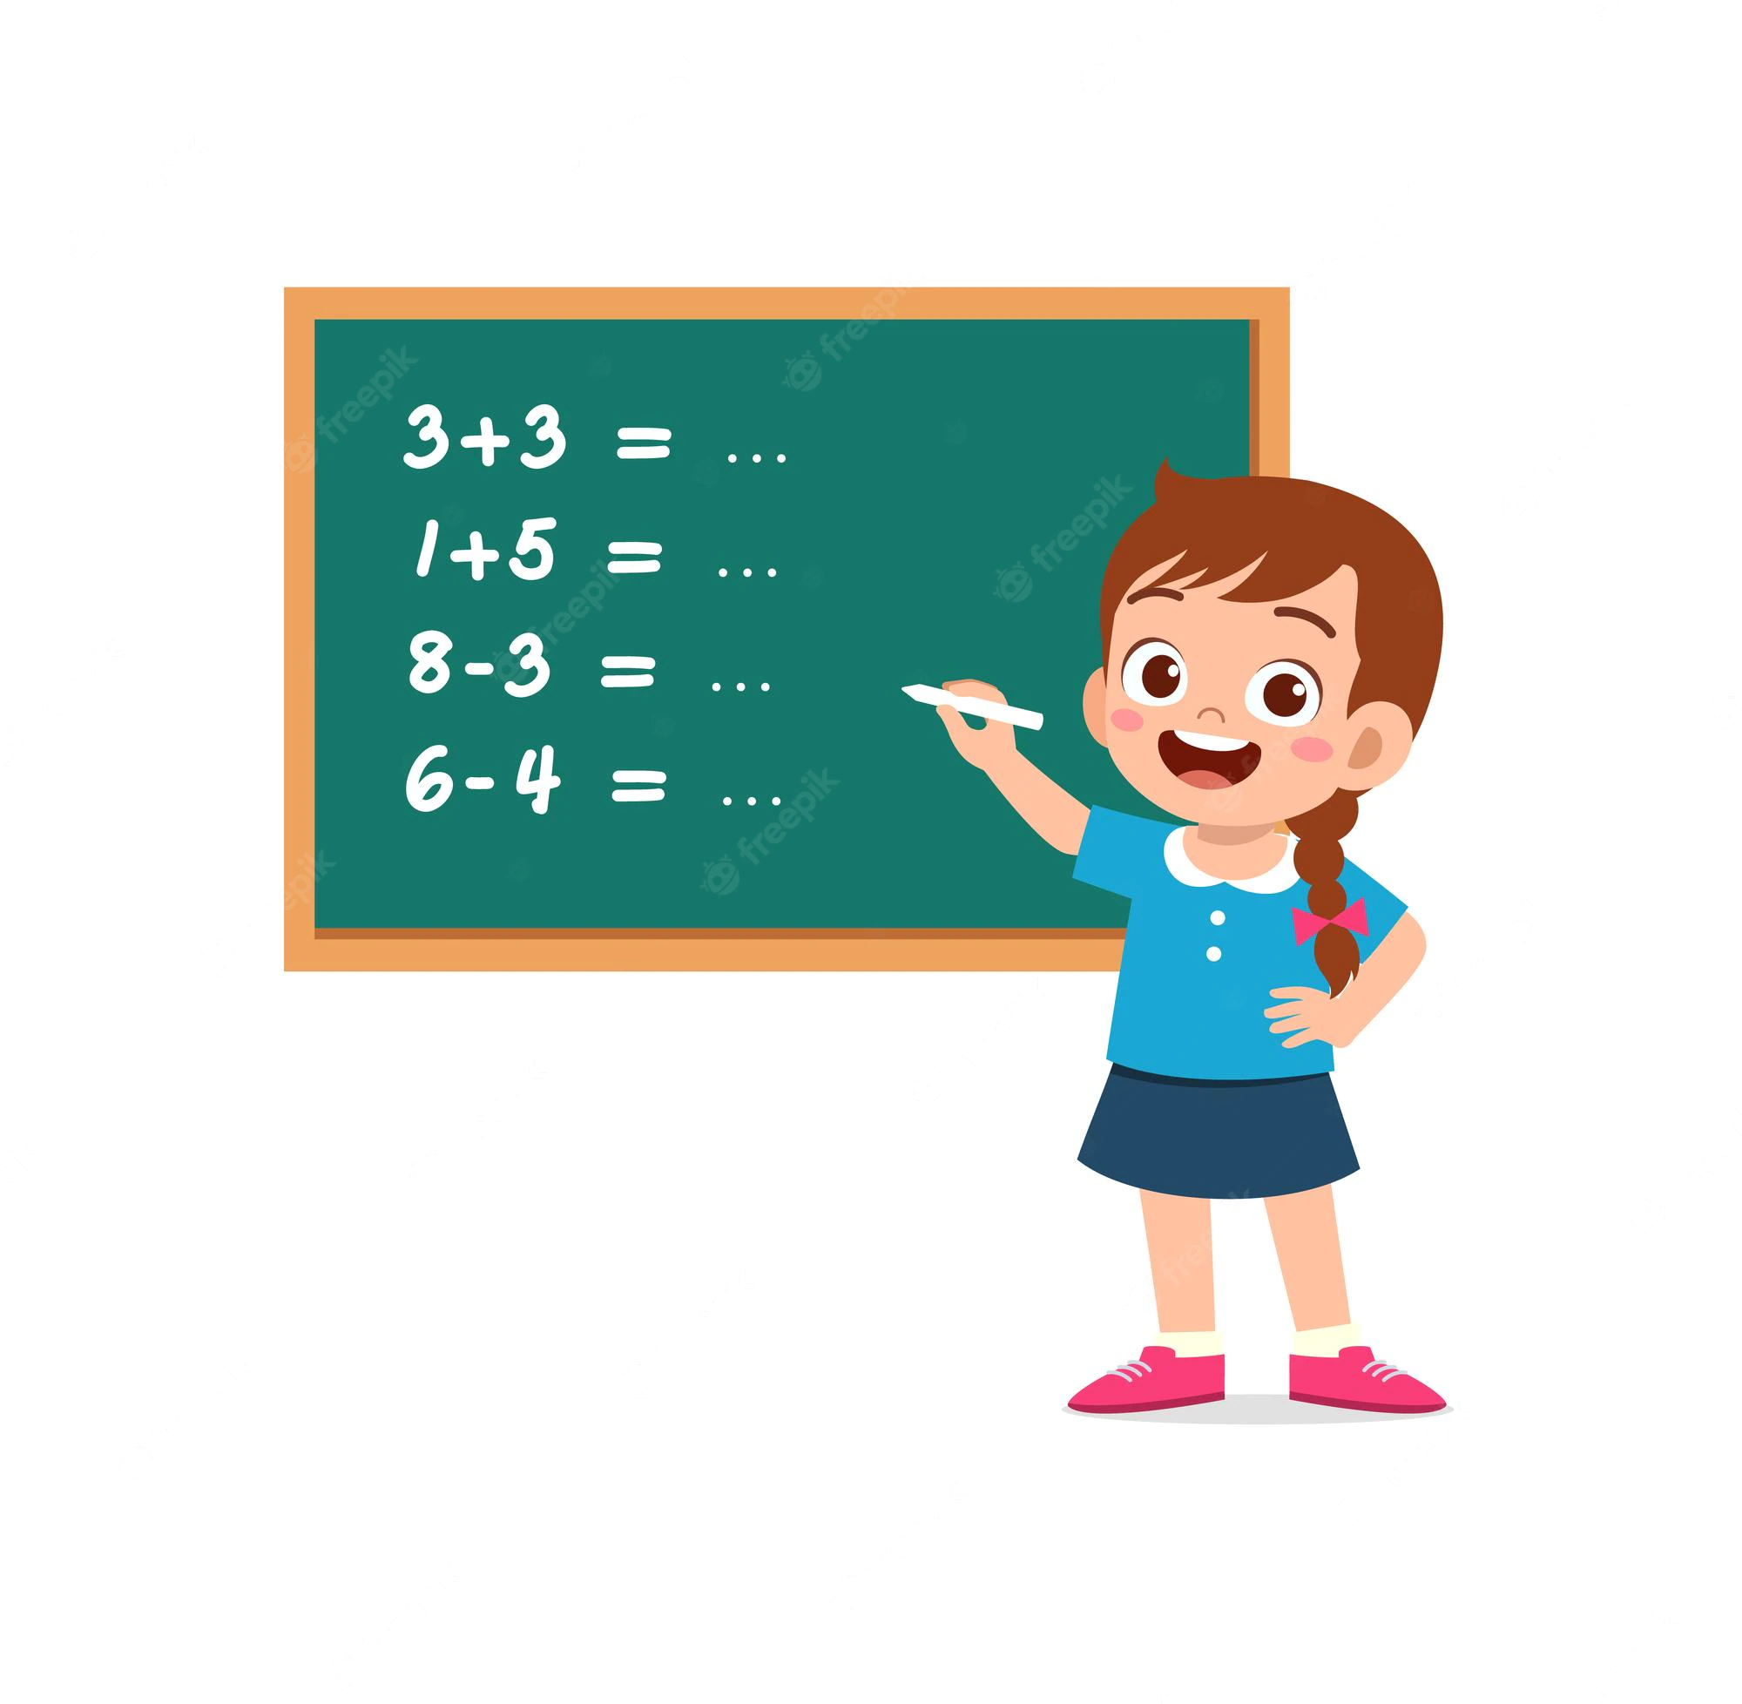
Practice – Challenge #1 – Think
Read the task (link) and think about possible solution.

Slide 7
Practice – Challenge #1 – Think
Implement the solution for the task.

Slide 8
Practice – Challenge #1
Resource: LeetCode
1061 Lexicographically Smallest Equivalent String – Link to the Task.
Solution: Disjoint sets.
Algorithm: O(N).
Memory: O(N).
Solution – Link to the Code.

Slide 9
Hometask
Resource: Competitive Programming 3:
Practice:
UVa 10765 – Doves and Bombs
Theory:
4.4.4. SSSP on Graph with Negative Weight Cycle.

Slide 10




Where to Practice
LeetCode [link]
HackerRank [link]
Kattis [link]
TopCoder [link]
Other Resources

